Slide 1
AI-Enhanced Gesture Recognition System for Virtual Smart Boards
Submitted in the partial fulfillment for the award of the degree of
BACHELOR OF ENGINEERING
IN
COMPUTER SCIENCE ENGINEERING (Hons.) AIML
Submitted by:
Satyam Kumar Singh (21BCS11016)
Kartik Kaushik (21BCS3713)
Nawal Kishor (21BCS6014)
Sejal Gogia (21BCS5517)
Under the Supervision of:
MR. SANT KUMAR MAURYA
Department of AIT-CSE
DISCOVER . LEARN . EMPOWER

Slide 2
Outline
Introduction to Project
Problem Formulation
Objectives of the work
Methodology used
Results and Outputs
Conclusion
Future Scope
References

Slide 3
Introduction to Project
The rapid advancement of interactive technologies has revolutionized human-computer interactions, especially with the development of gesture recognition systems. These systems, driven by computer vision and artificial intelligence (AI), interpret human hand gestures as commands to control various devices. The project "AI-Enhanced Gesture Recognition System for Virtual Smart Boards" aims to push the boundaries of these technologies by creating a hands-free, intuitive interface for writing and drawing on a virtual canvas.

Slide 4
Introduction to Project
The proposed system leverages deep learning models, such as Convolutional Neural Networks (CNNs) and Long Short-Term Memory (LSTM) networks, to recognize gestures in real time. By capturing hand movements using a standard HD camera, it eliminates the need for physical interaction with devices. This allows users to perform gestures in the air, which are then translated into writing or commands on a digital board. This project offers transformative potential for sectors like education, where educators can engage with digital lessons using gestures, and business, where hands-free collaboration becomes seamless.

Slide 5
Problem Formulation
Despite significant advancements in gesture recognition technology, the development of a robust, real-time system for virtual writing still poses major challenges. Creating such a system involves addressing multiple obstacles to ensure it can perform effectively in real-world applications.
Accuracy: One of the most critical challenges is achieving a high degree of precision in recognizing hand gestures. The system must reliably distinguish between subtle hand movements, accurately translating them into commands with minimal errors. Additionally, it needs to be adaptable to variations in hand shapes and individual movement styles, providing a seamless experience for all users.

Slide 6
Problem Formulation
Real-Time Performance: For a smooth and natural user experience, the system must process gestures quickly, delivering instantaneous feedback without delays. Real-time performance is essential to maintain an interactive and engaging environment, which requires efficient data processing and minimal lag.
Usability: The system needs to be intuitive and easy to use, minimizing the learning curve for new users. An ideal interface would allow users to interact effortlessly, without requiring complex gestures or extensive configuration. The goal is to ensure widespread usability across different contexts, from educational settings to professional environments.

Slide 7
Objectives of the Work
Develop a robust AI-based gesture recognition model using CNNs and LSTMs to classify hand gestures accurately.
Design a real-time virtual smart board interface for seamless writing, moving, and erasing gestures.
Ensure the system delivers high-speed performance with minimal lag and adapts to varying conditions.
Create an intuitive, user-friendly interface requiring minimal setup, enhancing accessibility and usability.
Evaluate the system's effectiveness through comprehensive testing and performance comparison.

Slide 8
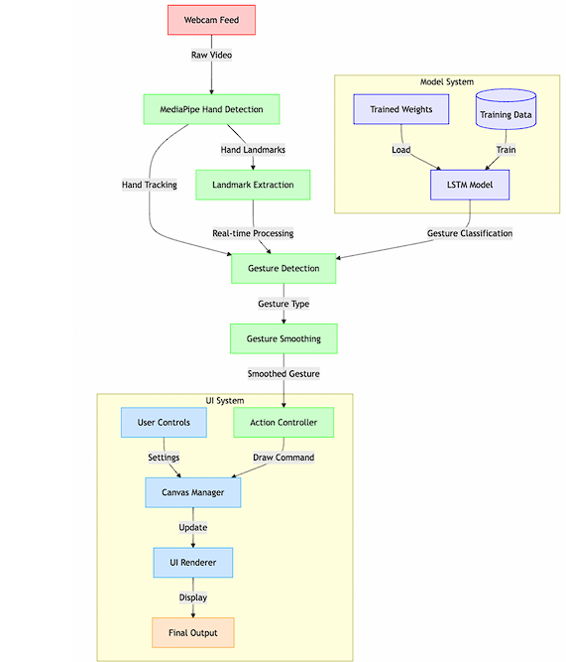
Methodology used
The proposed system implements a real-time hand gesture recognition model specifically designed for air writing, utilizing advanced computer vision and deep learning techniques. It operates with a multi- stage architecture composed of four principal components:

Slide 9
Methodology used
System Overview: Designed a multi-stage architecture including data collection, preprocessing, feature extraction, model training, and real-time recognition.
Data Collection: Used MediaPipe to capture diverse hand gesture data (21 landmarks) under varying conditions for robustness.
Preprocessing: Normalized and augmented data, structuring it into sequences for temporal analysis.
Feature Extraction: Derived 63-dimensional vectors from hand landmarks to represent gestures effectively.

Slide 10
Methodology used
Model Training: Built and trained an LSTM-based deep learning model, optimized with the Adam optimizer for high accuracy.
Real-Time Recognition: Implemented a real-time pipeline with gesture smoothing for stable predictions, integrated with a virtual smart board interface.
Performance Optimization: Used efficient frame processing and optimized MediaPipe settings for responsiveness and stability.

Slide 11
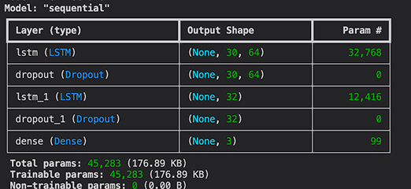
Results and Outputs
The trained model yielded strong performance metrics, demonstrating effective learning and high accuracy in recognizing gestures. The model architecture, based on Long Short-Term Memory (LSTM) networks, was tailored to process sequential landmark data effectively. This approach allowed for efficient pattern recognition in hand movements, translating them into actionable gestures in the application.

Slide 12
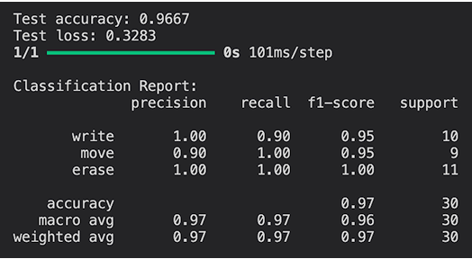
Results and Outputs
The use of LSTM layers in the model architecture enables it to capture temporal dependencies within the sequence data, making it highly suitable for the gesture recognition task. By processing the landmarks sequentially, the LSTM can identify gesture patterns across frames, enabling high recognition accuracy even when gestures are performed with slight variations in speed or position.

Slide 13
Results and Outputs
Overall Performance Metrics
Test Accuracy: 0.9667
Overall accuracy of the model (correct predictions / total predictions). Shows the model correctly classifies about 97% of all test cases.
Test Loss: 0.3283
Model's loss value on test data, indicating how far predictions deviate from actual values. Lower values indicate better model confidence. Average Metrics
accuracy
Value: 0.97
Support: 30

Slide 14
Results and Outputs
Overall accuracy across all classes, showing strong general performance.
macro avg
Value: 0.96-0.97
Support: 30
Simple average of per-class metrics, treating all classes equally regardless of size.
weighted avg
Value: 0.97
Support: 30
Average weighted by class support, accounting for class imbalance in the dataset.

Slide 15
Conclusion
The AI-Enhanced Gesture Recognition System for Virtual Smart Boards successfully demonstrates the integration of advanced computer vision and deep learning techniques to enable intuitive, real-time gesture-based interactions. By using CNNs and LSTMs, the system achieves high accuracy and efficiency, transforming traditional input methods into a hands-free, user-friendly experience. The project addresses key challenges like real-time performance and hardware independence, making it adaptable for diverse environments and applications, such as education and business. Future work will focus on expanding the gesture library and enhancing system adaptability, paving the way for broader adoption and impact in human-computer interaction.

Slide 16
Future Scope
Expanded Gesture Library: Introduce additional gestures to enhance functionality and enable more complex interactions with the virtual smart board.
Multi-User Support: Develop capabilities for simultaneous gesture recognition from multiple users, allowing collaborative use in classrooms or meetings.
Adaptability: Improve the system’s robustness to work in diverse environments, including varying lighting conditions and backgrounds.
Integration with Emerging Technologies: Explore integration with AR/VR for immersive experiences or with IoT devices for smart home and office automation.

Slide 17
References
1. Lech, M., & Kostek, B. (2010). Gesture-based computer control system applied to the interactive whiteboard. Fuzzy rule-based gesture recognition, Image processing, Camera and multimedia projector integration.
2. Chen, T., Wu, Y., Yang, D., & Zhang, Y. (2021). GestOnHMD: Enabling gesture-based interaction on low-cost VR head-mounted display. Gesture-classification pipeline using stereo microphones in mobile VR headsets, deep learning for gesture recognition.
3. Suarez, J., & Murphy, R. R. (2012). Hand gesture recognition with depth images: A review. Kinect and OpenNI libraries for hand tracking, Depth-based gesture recognition methods. Hand localization techniques.
4. Cheng, H., Yang, L., & Liu, 7.. (2015). Survey on 3D hand gesture recognition. 3D hand modeling, Static and dynamic gesture recognition, Hand trajectory tracking, Dynamic time warping, Skeleton derection.
5. Patel, J., Bhagat, S., & Verma, A. (2022). Virtual Board: A Digital Writing Platform for Effective Teaching-Learning. Digital writing technology, Air-tapping for gesture recognition. User experience testing and feedback collection.
6. Ullah, A., Shah, R., & Khan, M. (2017). Action recognition in video sequences using deep bi-directional LSTM with CNN features. Convolutional Neural Networks (CNN) for deep feature extraction, Deep Bidirectional LSTM (DB-LSTM) for action recognition.

Slide 18
References
7. Bin, Y., Zhang, Q., & Li, X. (2018). Describing video with attention-based bidirectional LSTM. Bidirectional LSTM (BILSTM), Sofi attention mechanism for enhanced video caption generation
8. Zhang, Z., Chen, Q., & Li, J. (2014). Hand gesture recognition using depth and intensity images. Depth and intensity image-based recognition, Feature extraction, Classifier integration.
9. Wang, L., Zhang, J., & Liu, X. (2019). 3D hand pose estimation from monocular images using deep learning. Deep learning-based 3D hand pose estimation, Convolutional Neural Networks
(CNN), Feature mapping from monocular images.
10. Al-Basyuni, S., Zhang, M., & Sidharta, A. (2020). Gesture-controlled interaction for 3D virtual environments. 3D hand tracking, Gesture recognition for 3D environments, Real-time tracking system development.

